Slide 1
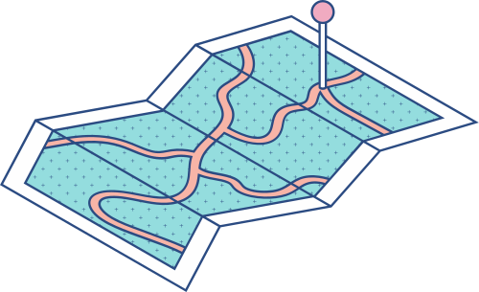





Selected Topics CS-2

Slide 2

Our Project Idea
OBJECT-DETECTION USING INCEPTION

Slide 3






We used Dataset Called "Car License Plate Detection"

Slide 4
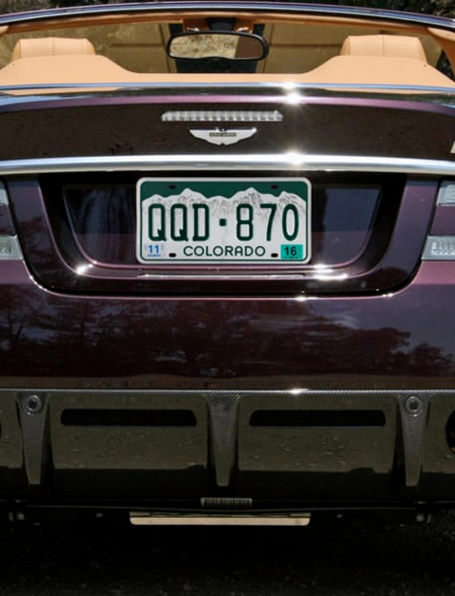
Some Information About Our Dataset
The Total Number of Images: 433.
4 Regression Output (X min ,X max ,Y min ,Y max)

Slide 5
The Main Steps of The Project
1
2
3
4
5
STEP
STEP
STEP
STEP
STEP
NORMALIZE & PREPROCESSING OUR DATA
Split The Data
BUILDING INCEPTION 4
FROM SCRATCH.
TRANSFER LEARNING USING INCEPTION_RESNETv2
TUNNING THE MODEL

Slide 6
Data Preprocessing:
Preprocessing steps are used to get the data into a format that can be used by the machine learning model. In this case, we are working with images, so preprocessing involves resizing the images to a standard size (224x224 pixels)
Normalization technique :
We use normalization to scale the labels down to values between 0 and 1, which makes it easier for the machine learning model to work with the data. This is done by dividing the bounding box coordinates (xmin, xmax, ymin, ymax) by the width and height of the image, respectively. The resulting values are then used as the normalized labels for the model.
STEP 1:
NORMALIZE AND
PREPROCESSING

Slide 7
Data Splitting for Training and Testing:
Students have access to different channels where they can communicate and collaborate with teachers and fellow students. After preprocessing the data, the images and their corresponding normalized labels were split into training and testing sets using the train_test_split() function from the scikit-learn library. We used 80% of the data for training and the remaining 20% for testing. The resulting training and testing datasets were then used to train and evaluate a machine learning model for car plate detection.
STEP 2:
SPLIT THE DATA

Slide 8
STEP 3:
BUILDING INCEPTION 4
FROM SCRATCH
The Inception Architecture:
The Inception architecture is a deep neural network designed for image recognition. It's made up of multiple layers that work together to analyze images and identify objects within them. One of the key features of the Inception architecture is its use of Inception modules. These modules are made up of multiple parallel layers that process the input image in different ways. By combining the outputs of these layers, the module is able to capture more information about the image. There are three types of Inception modules: Inception A, Inception B, and Inception C. Each module has a slightly different structure, with different combinations of convolutional layers and pooling operations.

Slide 9
Using InceptionResNetV2
We're using a pre-trained deep neural network called InceptionResNetV2 to create a new model for image classification. This pre-trained model has already learned how to recognize many different objects in images. We're going to take the pre-trained model and add a new "head" to it. This head will consist of two dense layers that will be trained to classify images into one of four categories. To create the head, we'll first get the output of the pre-trained model. Then, we'll flatten the output and add two dense layers with a rectified linear activation function. The first dense layer will have 500 neurons, and the second dense layer will have 4 neurons (one for each category). Finally, we'll use the sigmoid activation function to ensure that the output of the model is between 0 and 1. The resulting model will take an input image with dimensions of 224x224x3 and output a probability for each of the four categories.
STEP 4:
TRANSFER LEARNING USING INCEPTION_RESNETv2

Slide 10
Comparing Optimizers
We want our neural network to learn from data and make accurate predictions. To do this, we need to choose an optimizer, which is a tool that helps the network adjust its parameters during training. There are different types of optimizers, and two common ones are SGD and Adam. SGD stands for Stochastic Gradient Descent and Adam stands for Adaptive Moment Estimation. SGD works by updating the parameters in the direction of the steepest descent of the loss function with respect to the parameters. This means that it tries to find the minimum of the loss function by taking small steps in the direction of the negative gradient. Adam, on the other hand, uses a more complex algorithm that combines ideas from both momentum and adaptive learning rates. It keeps track of the gradient's mean and variance to adjust the learning rate for each parameter. This makes Adam a more adaptive optimizer compared to SGD.
STEP 5:
TUNNING
THE MODEL

Slide 11
So,When we apply all these steps and test our model on real data, we achieve good results and a low mean loss.

Slide 12
OUR TEAM
Ahmed Khaled Abdel-Fattah Saad
Mohammed Osama Fayyad Abdou Shata
Yasra Ramadan Abdelwahab Gad
Mohammed Hosny Abu Al-Wafa Mohammed
Mikhail Sami Louis Sous
Beshoy Atiya Nadi

Slide 13
https://www.researchgate.net/profile/Mohammed-Alom-2/publication/352497171_Adam_Optimization_Algorithm/links/60cc01fe299bf1cd71d8f1f9/Adam-Optimization-Algorithm.pdf
https://www.section.io/engineering-education/image-preprocessing-in-python/
https://www.v7labs.com/blog/transfer-learning-guide
https://arxiv.org/abs/1602.07261v2
Our GitHub Link: https://github.com/mohamedshata2002/object_detection_cars
Resource Page

